Slide 1
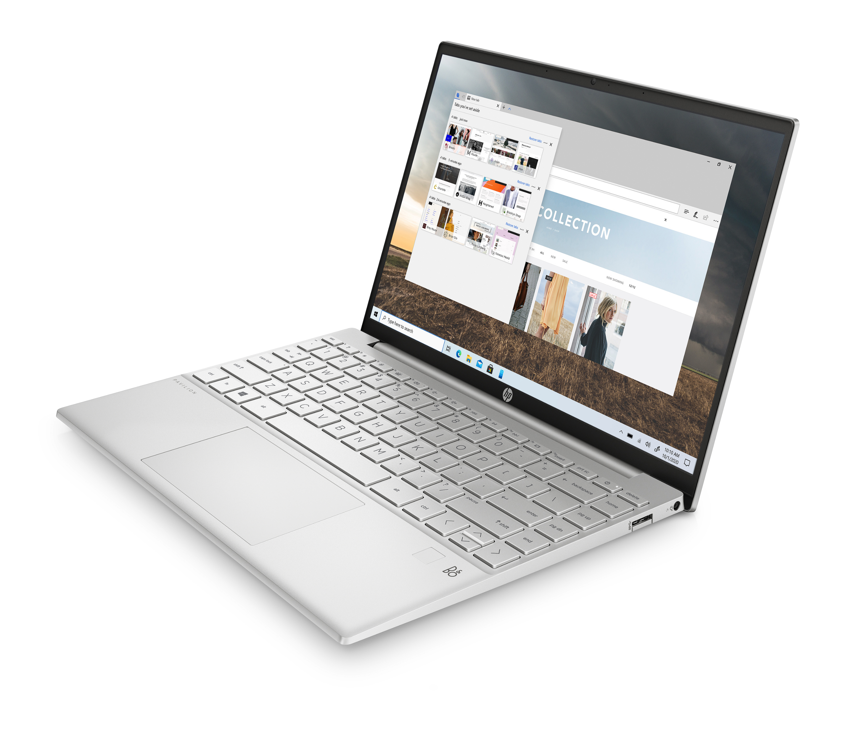
NOTEBOOK, KTERÝ MĚNÍ PRAVIDLA HRY
HP Pavilion Aero 13’’
HP Pavilion Aero 13’’
Karel Kotík, 21.04.2022
Notes:
Portability and weight have constantly shown up in user surveys as one of the top items where HP can do better.
Our insights show that Portability is ranked high, in the top half, as a key motivation for purchasing a PC. (Source: HP Consumer Device Behavior, Understanding Observed Use of PCs, Smartphones, and Tablets (Oct 2019).)
Weight condition:
Magnesium alloy TP bracket
Aluminum Fan cover
0.3t Aluminum KB supporting bracket
Aluminum Thermal fin
0.9mm PCB thickness
Magnesium Alloy Chassis (A/C/D cover)
Weight includes FPR, Backlit keyboard, excludes lid-closed WOV
Under 1kg (2.2lbs)

Slide 2
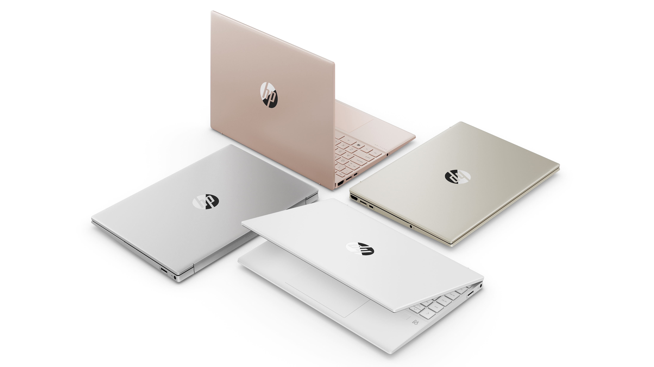
HP Pavilion Aero 13’’
Barevné varianty
Notes:
Magnesium alloy chassis
Starcraft is a ENVY 14’’ with 16:10 display
*Excluding SKUs with LED lightbar for WOV
Mag Al

Slide 3
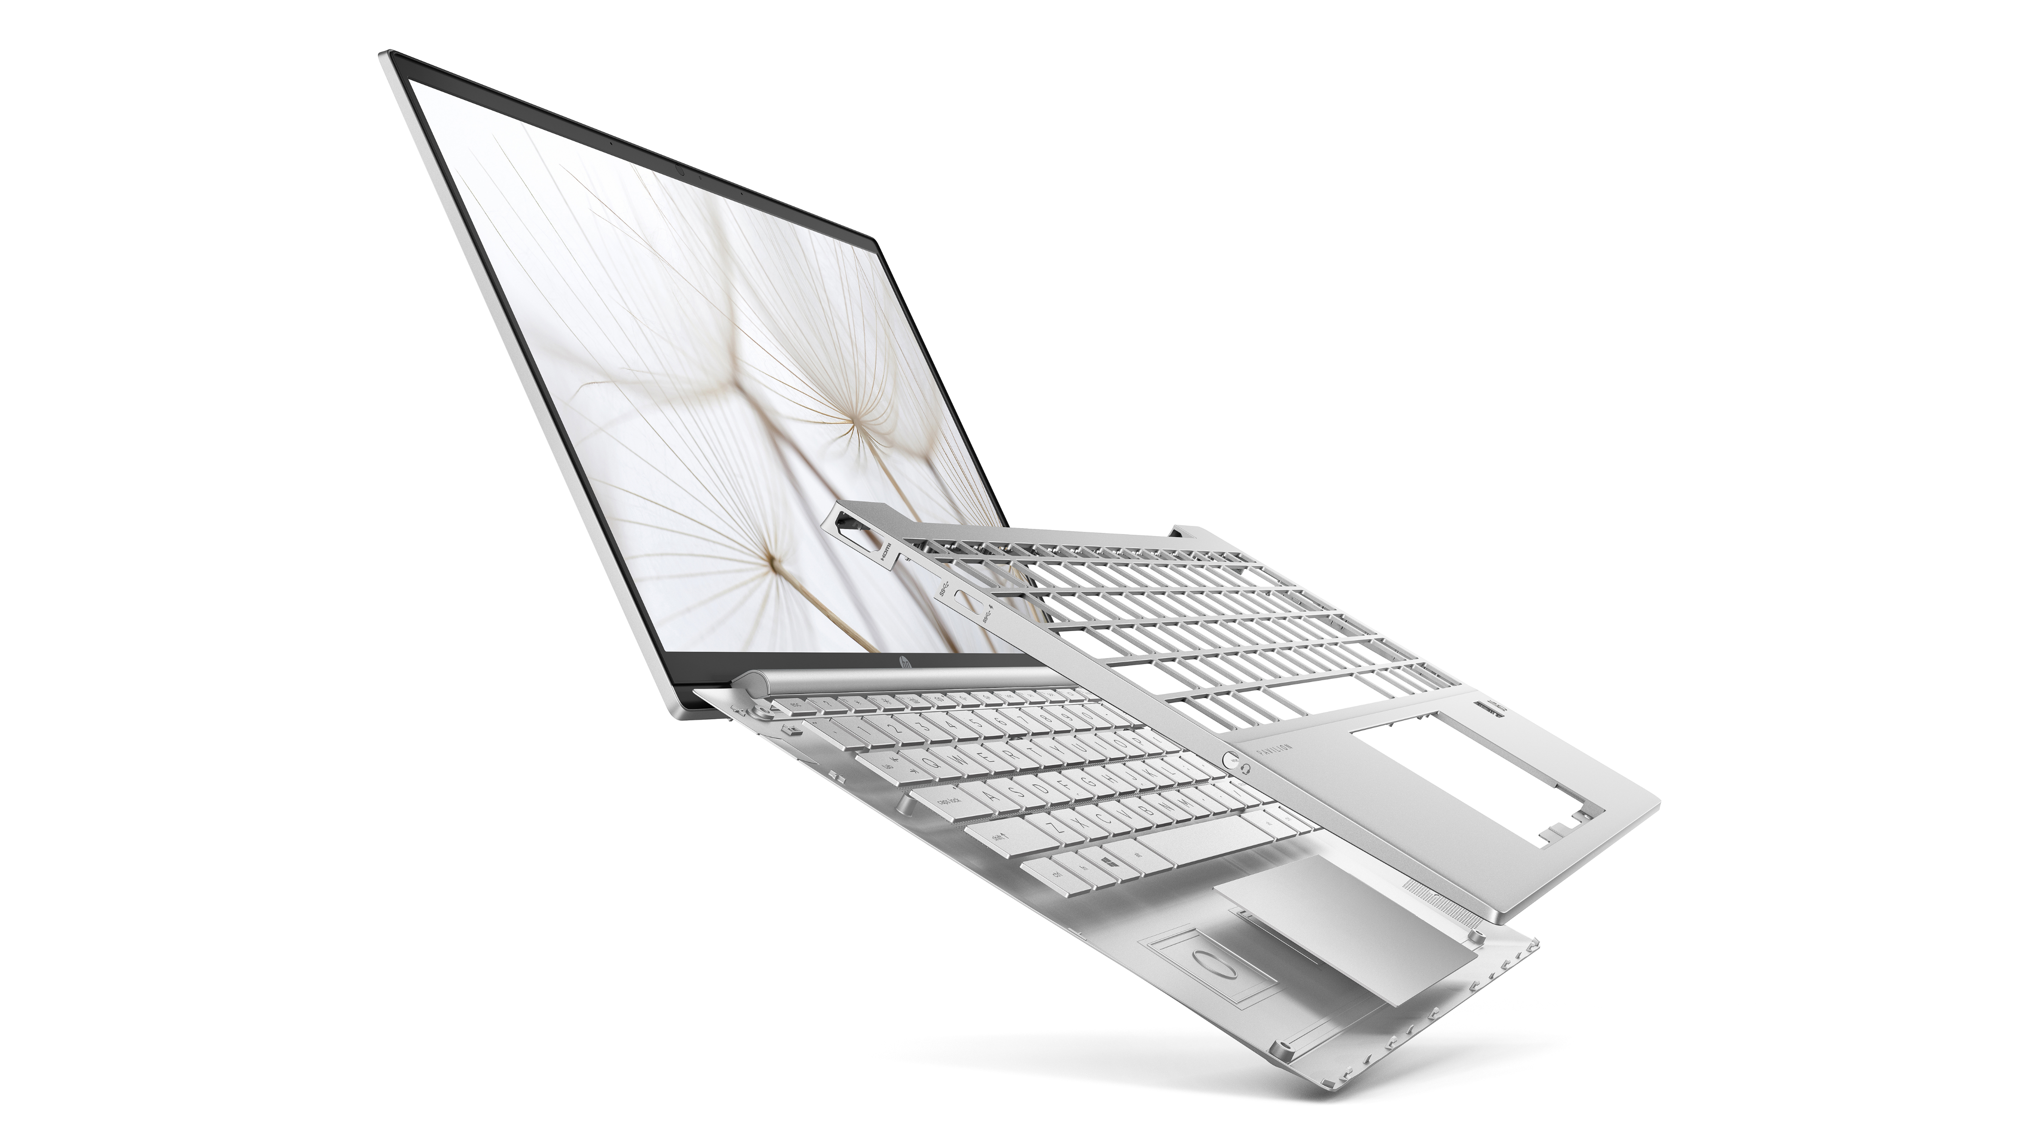
HP Pavilion Aero 13’’
Neuvěříte, jak lehký je
< 1Kg
Notes:
Portability and weight have constantly shown up in user surveys as one of the top items where HP can do better.
Our insights show that Portability is ranked high, in the top half, as a key motivation for purchasing a PC. (Source: HP Consumer Device Behavior, Understanding Observed Use of PCs, Smartphones, and Tablets (Oct 2019).)
Weight condition:
Magnesium alloy TP bracket
Aluminum Fan cover
0.3t Aluminum KB supporting bracket
Aluminum Thermal fin
0.9mm PCB thickness
Magnesium Alloy Chassis (A/C/D cover)
Weight includes FPR, Backlit keyboard, excludes lid-closed WOV
Under 1kg (2.2lbs)

Slide 4
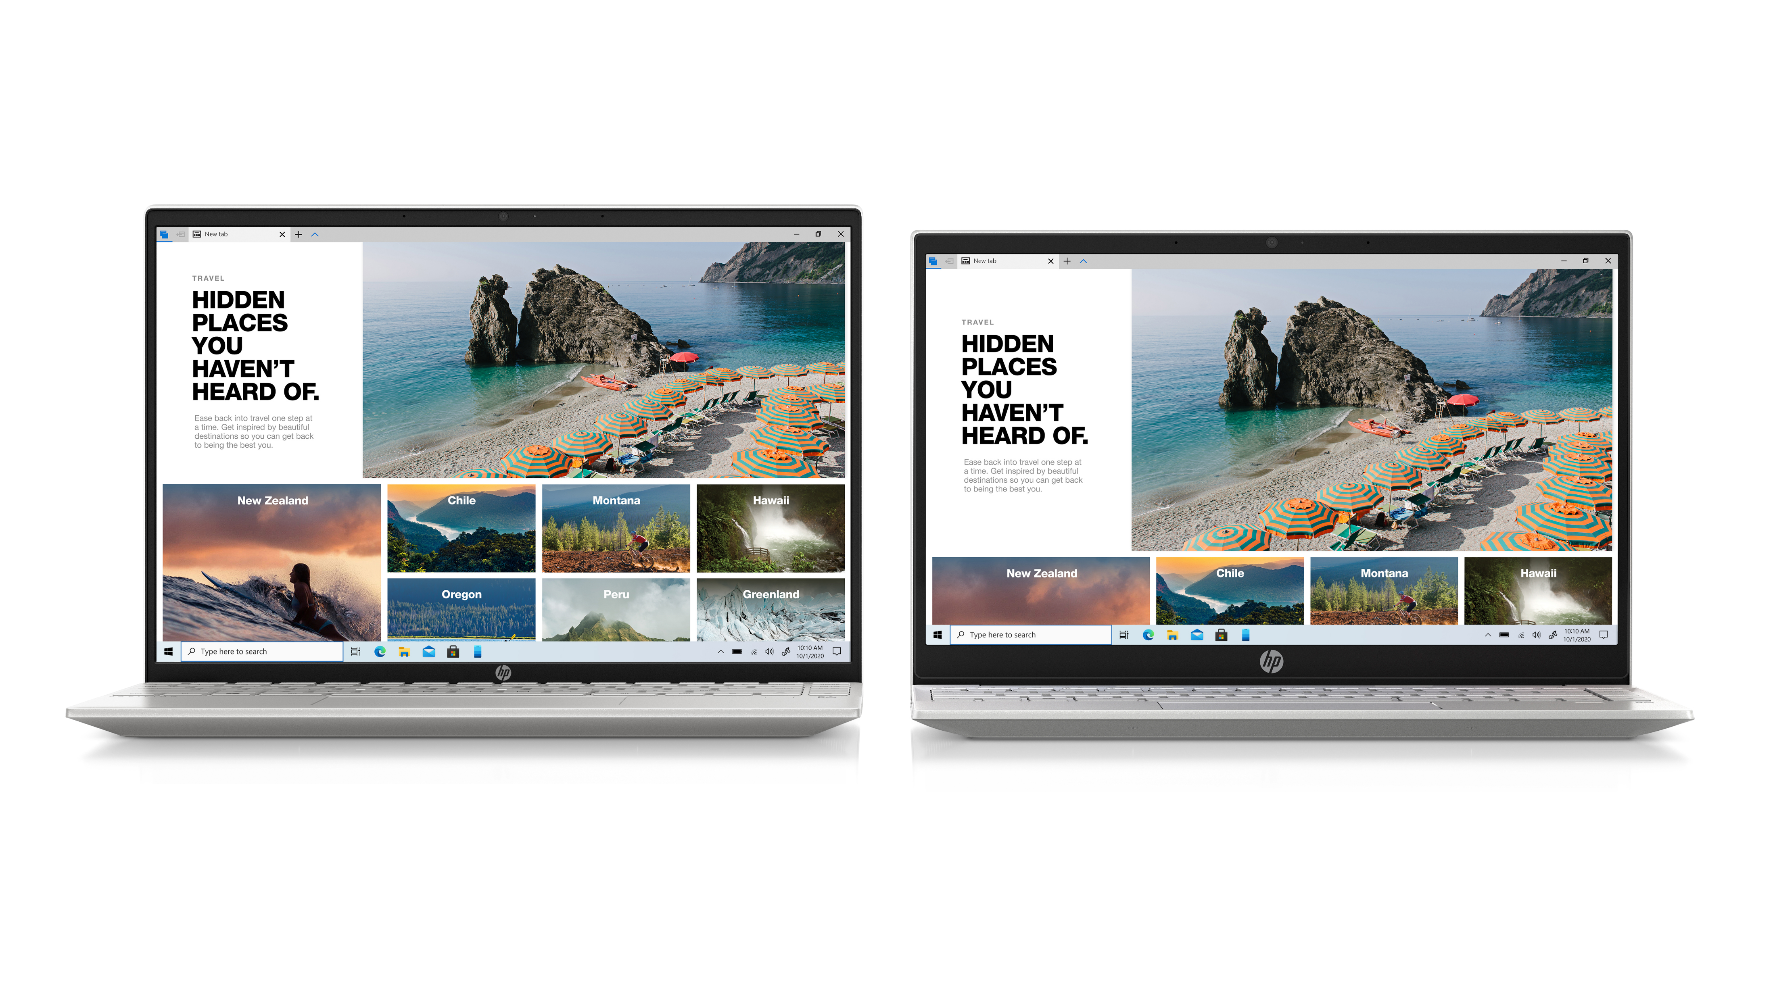
HP Pavilion Aero 13’’
Méně rámečků, více obrazu
HP Pavilion 13 (2021)
HP Pavilion 13 (2020)
90% SBR
84% SBR
9.69mm
16.19mm
4-stranný rámeček s minimálními okraji
3-stranný rámeček s minimálními okraji
Notes:
Zurg:
4-sided Micro-Edge bezel
Bezel Dims: 3.47mm/3.47mm/6.82mm/9.69mm
Zurg Dims: 298 x 209 x 16.9mm
STBR 90%
Able
3-sided Micro Edge Bezel
Bezel Dims: 4.35mm/4.35mm/8.26mm/16.19mm
Able Dims: 309 x 205 x 16.9mm
STBR 84%

Slide 5
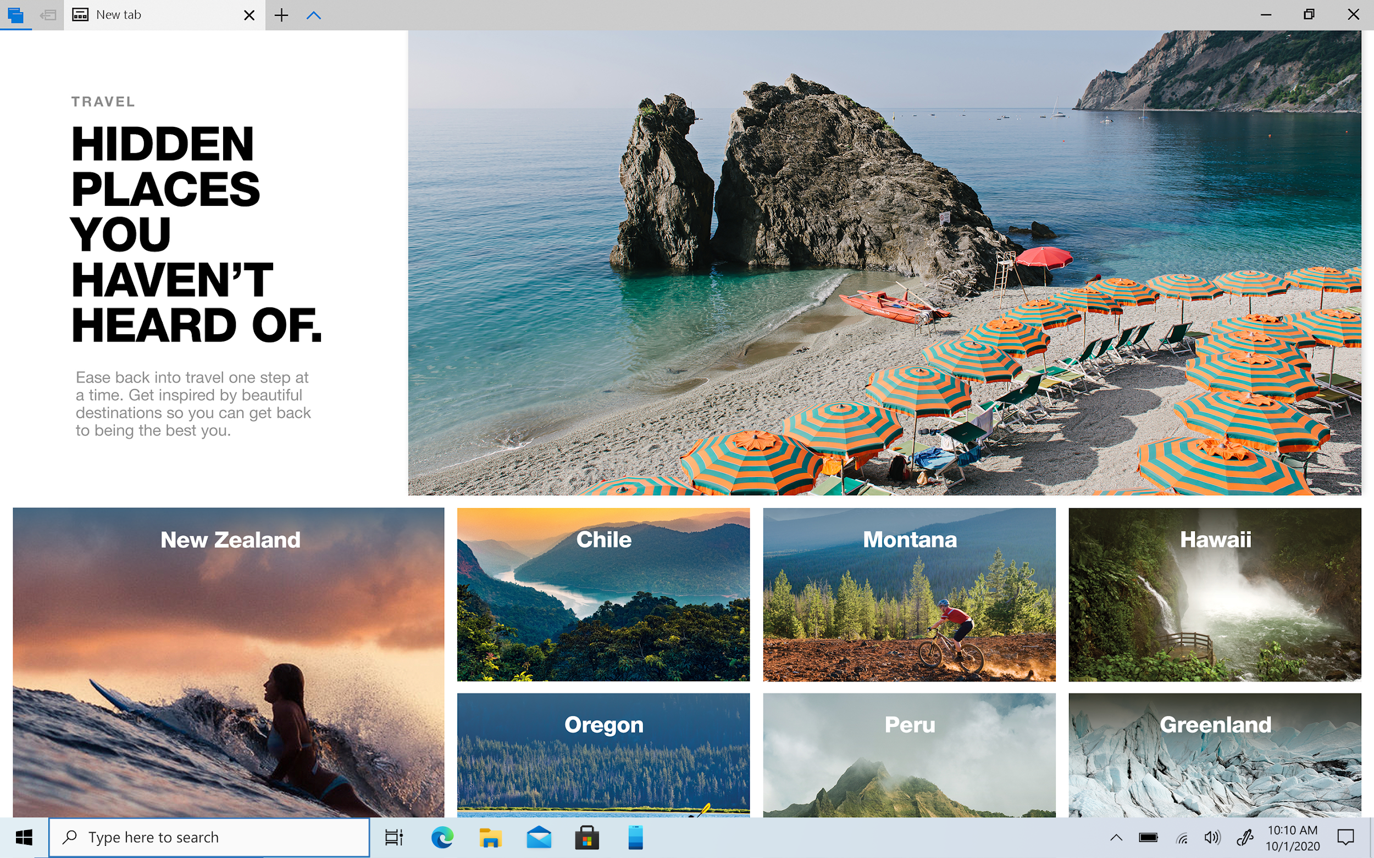
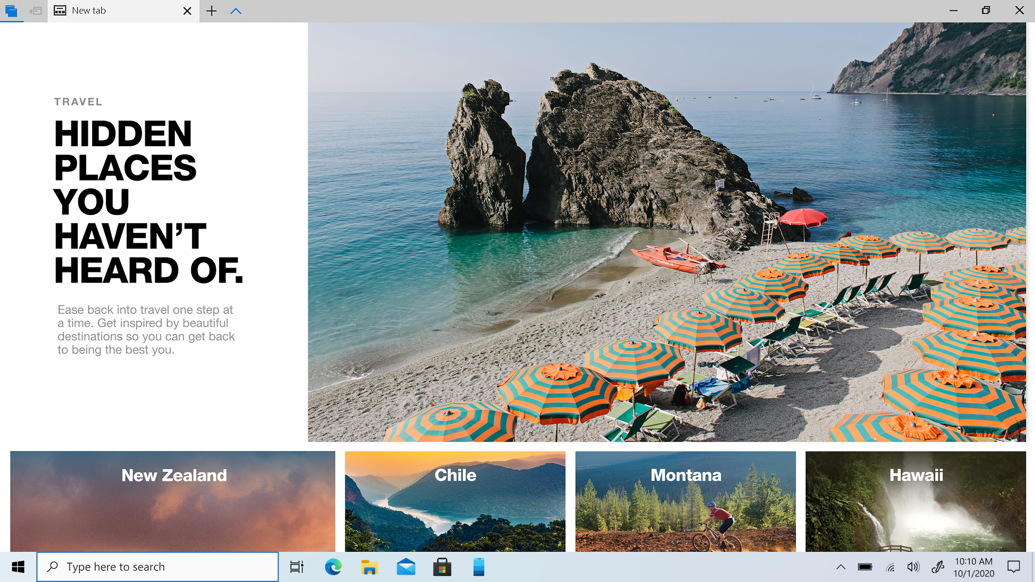
HP Pavilion Aero 13’’
Více obsahu díky 16:10
HP Pavilion 13 (2021)
HP Pavilion 13 (2020)
poměr stran 16:10
poměr stran 16:9
~10% více vertikálního prostoru
Notes:
With the 16:10 aspect ratio, this gives you more screen real estate, allowing you to see more content with less scrolling, so the real benefit would be with web browsing, or reading a document vs watching a movie on the 16:9 aspect ratio
Compared to Able, you get about 10% more vertical viewing space for better productivity and you see more content which is especially beneficial for a smaller formfactor like zurg

Slide 6
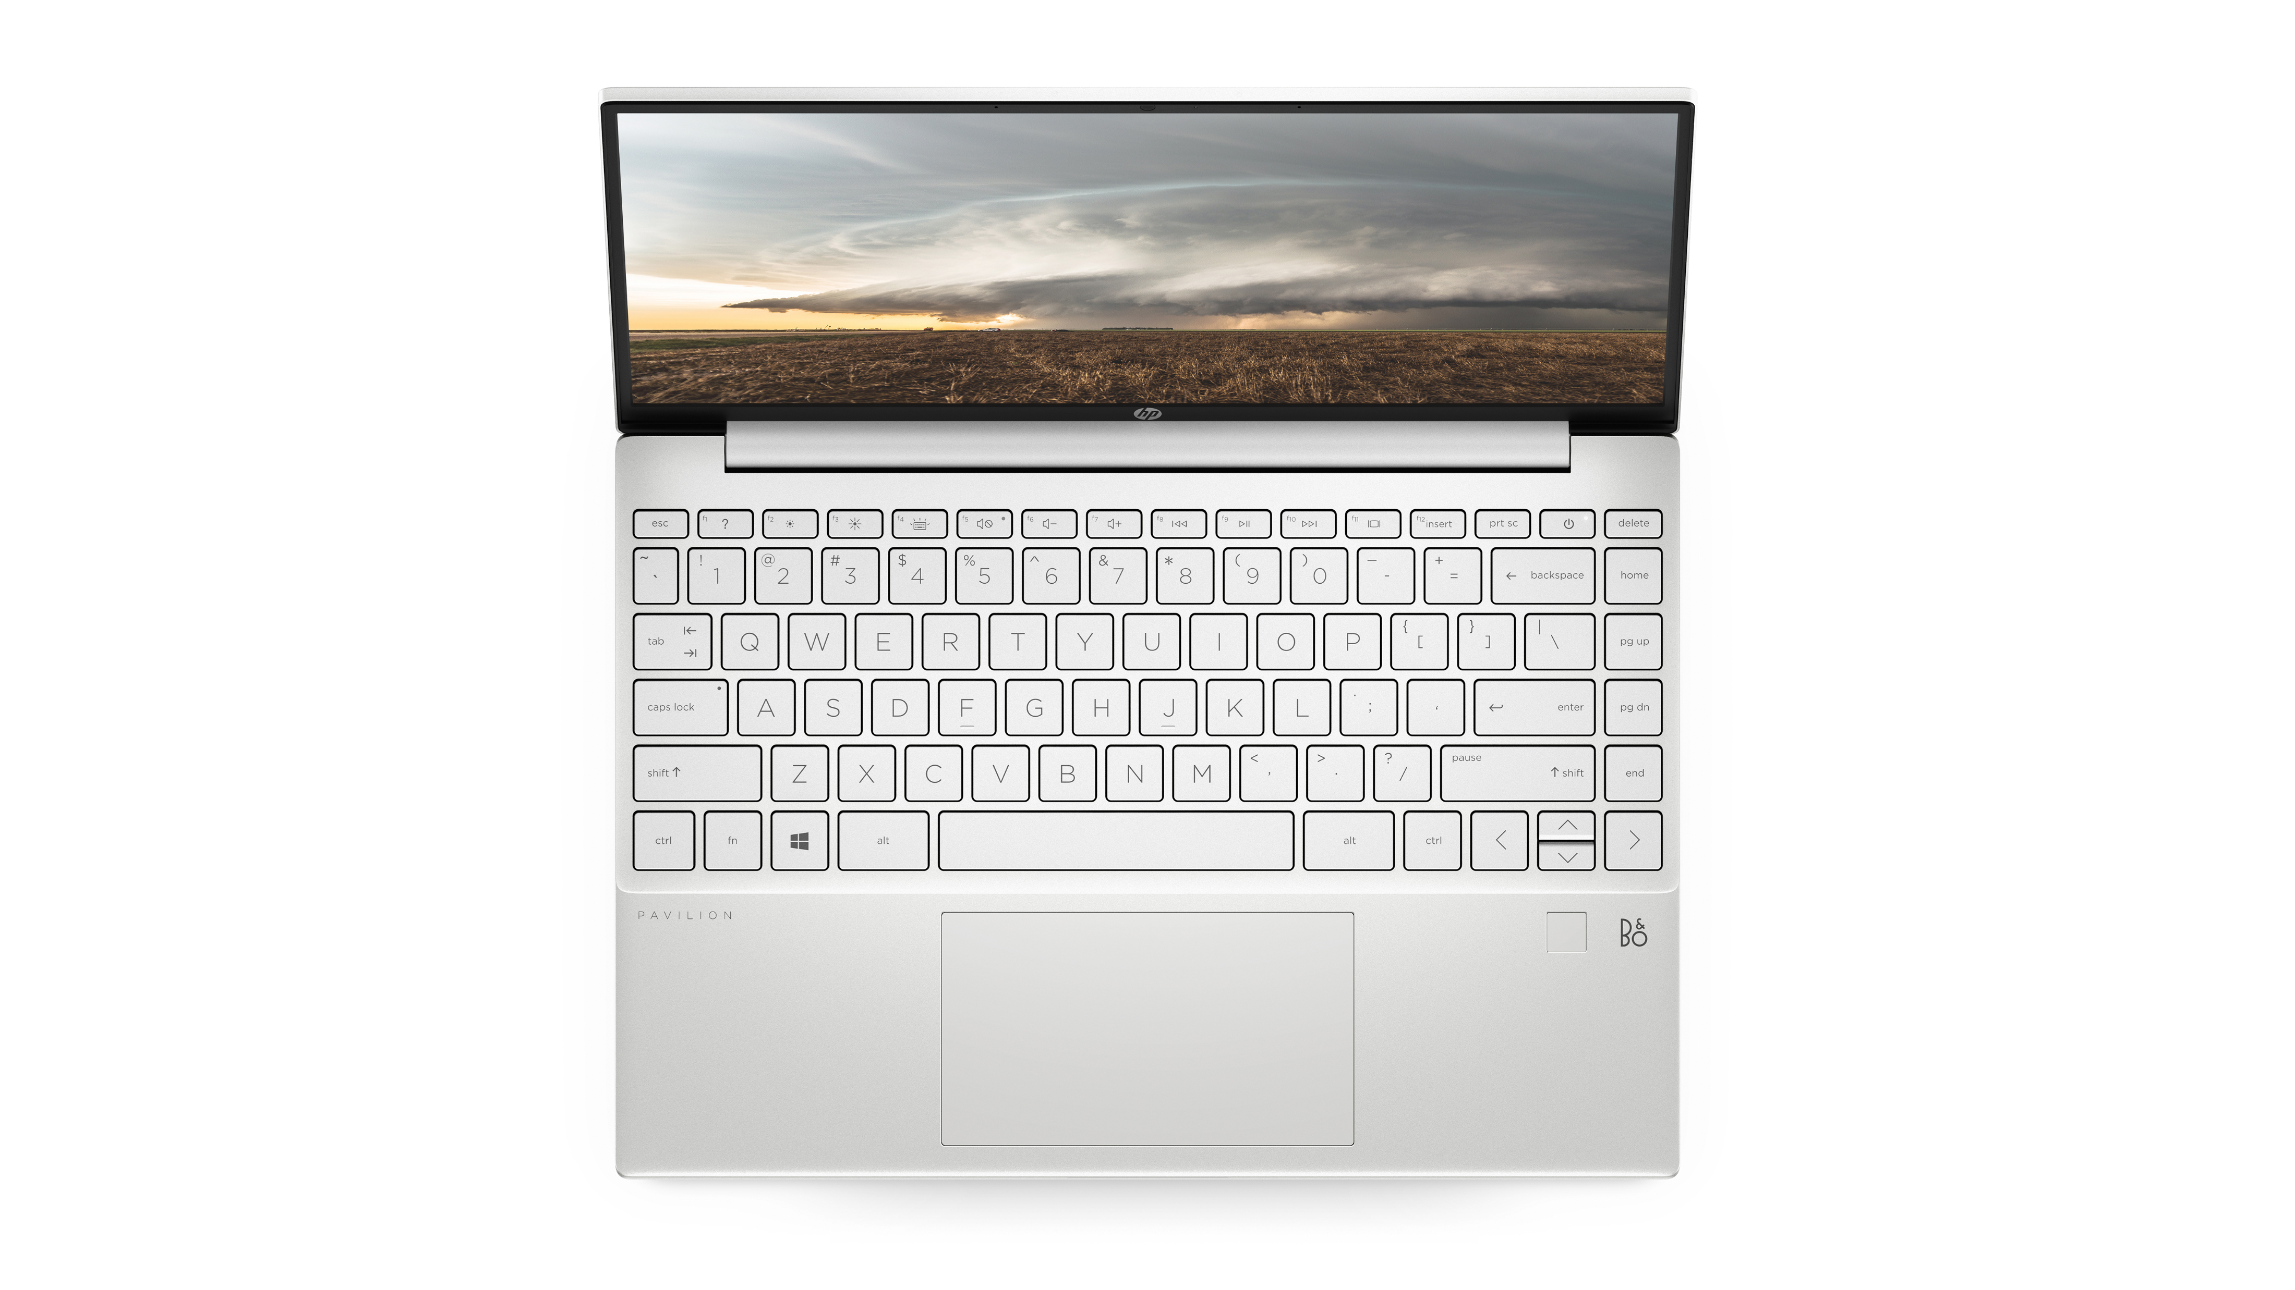
HP Pavilion Aero 13’’
Velký touchpad jak potřebujete
o 23%
větší, modernější
a přesný touchpad
Notes:
23% larger more modern touchpad gen over gen for easier navigation

Slide 7
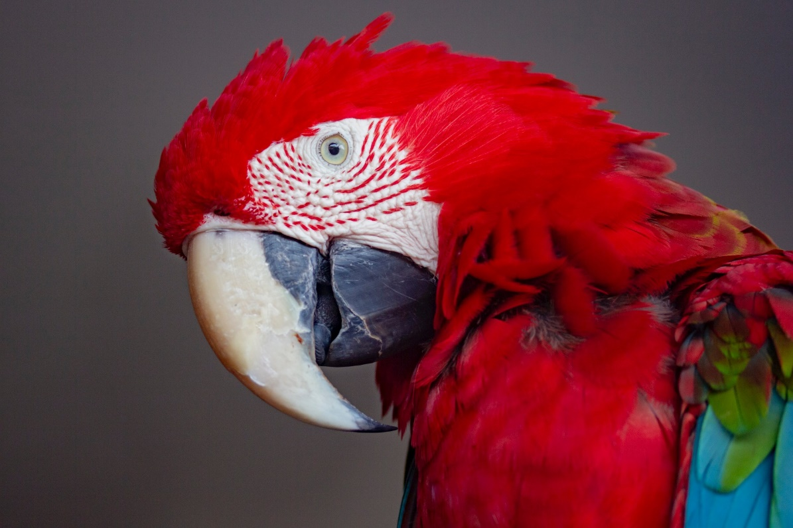
HP Pavilion Aero 13’’
Vysoké rozlišení pro kreativce
FHD
vs.
WQXGA - 2.5k rozlišení
1600
1080
1920
2560
WQXGA rozlišení 2,5k téměř zdvojnásobuje počet pixelů na více než 4 miliony, snímky vypadají ostřejší a detailnější
Notes:
23% larger more modern touchpad gen over gen for easier navigation

Slide 8
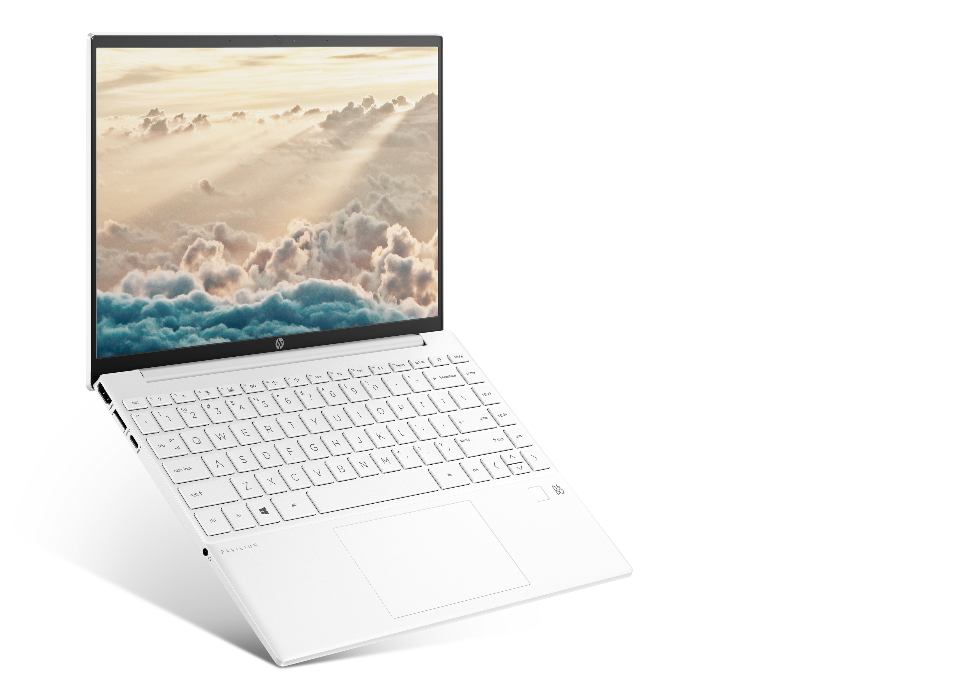
HP Pavilion Aero 13’’
Proč mění pravidla hry?
Klíčové vlastnosti
Nejlehčí consumer notebook <1kg
Pavilion s plně Mg konstrukcí
13.3’’ notebook s poměrem displeje 16:10
Pavilion s nejvyšším STBR ~90%
13.3’’ zařízení možností až 2.5K rozlišení
Notes:
Magnesium alloy chassis
Starcraft is a ENVY 14’’ with 16:10 display
*Excluding SKUs with LED lightbar for WOV
Mag Al

Slide 9
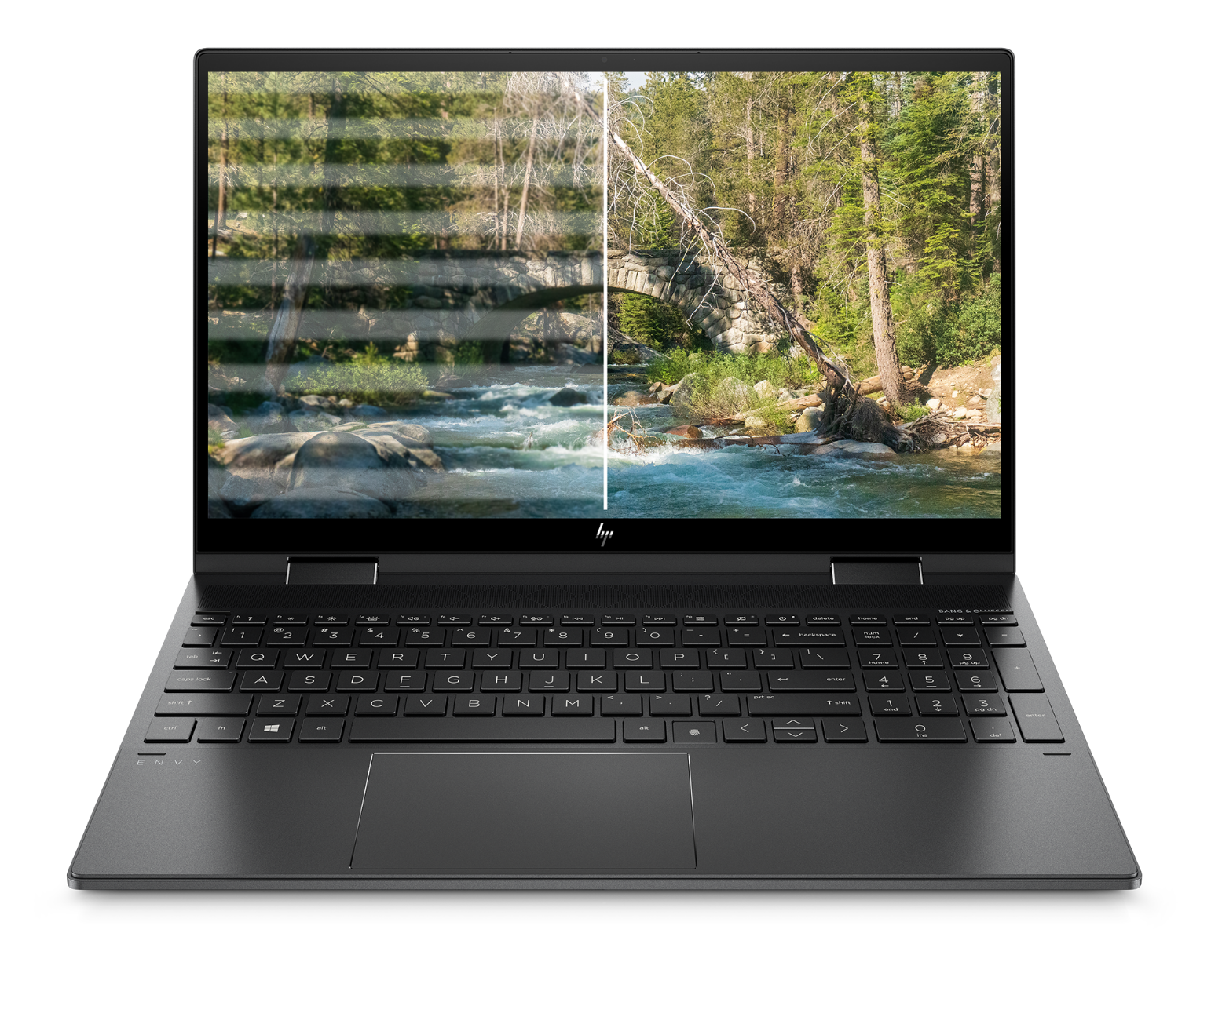
HP Pavilion Aero 13’’
Flicker Free ochrání váš zrak
bez Flicker-Free
Flicker-Free
Pohodlné používání na prvním místě
Technologie Flicker Free eliminuje blikání obrazovky při nízkém jasu
Redukuje jas pomocí stejnosměrného proudu
Zmírňuje únavu očí nebo bolest hlavy
Pulse-width module (PWM)
DC stmívání (prodloužení frekvence pomocí regulace proudu)
Notes:
Magnesium alloy chassis
Starcraft is a ENVY 14’’ with 16:10 display
*Excluding SKUs with LED lightbar for WOV
Mag Al

Slide 10
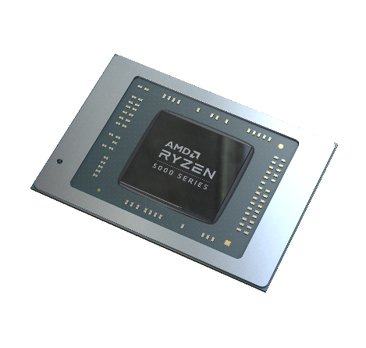
HP Pavilion Aero 13’’
Výkonný díky procesorům AMD RYZEN™ řady 5000
Nové možnosti
7nm technologie s Zen3 architekturou
Až o 25% výkonnější multi-thread oproti předchozí generaci
Až o 22% výkonnější grafický čip oproti předchozí generaci
Vhodný pro zábavu i práci
Sledujte videa v rozlišení až 4K
Plynulé hraní ve FullHD s grafickou kartou AMD Radeon™
Podpora Wi-Fi 6
CPU | AMD Ryzen™ 5000 U-Series Mobile Processors (Cezanne U)
Ryzen 7 | Ryzen 7 5800U 8 core, 16 thread, 20MB Cache, Up to 4.4 GHz
Ryzen 5 | Ryzen 5 5600U 6 core, 12 thread, 19MB Cache, Up to 4.2 GHz
Notes:
23% larger more modern touchpad gen over gen for easier navigation

Slide 11
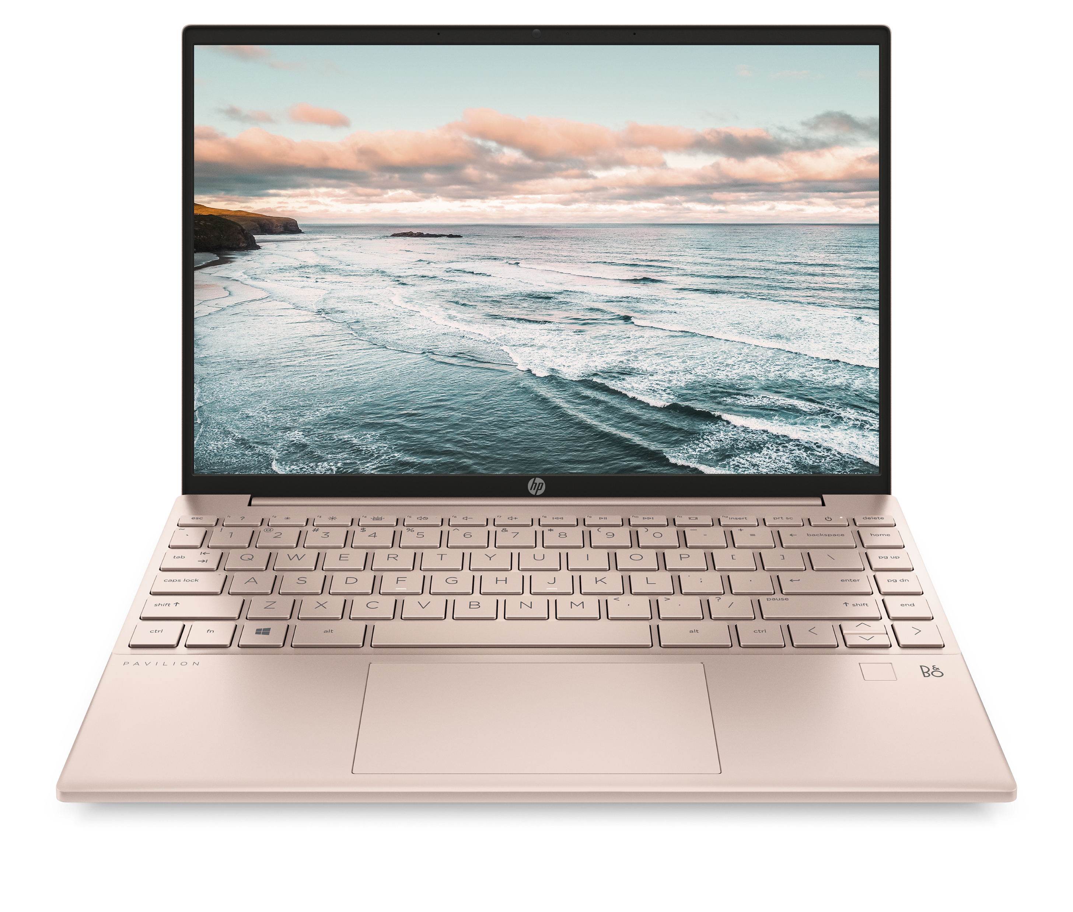
HP Pavilion Aero 13’’
Shrnutí
Výkon pro každodenní zábavu i práci
AMD Ryzen™ 5000 U R5/R7
AMD Radeon™ Graphics
Rychlý jak potřebujete
On-Board Dual Channel paměť 8GB/16GB
SSD až 1TB
Nezávislý na zásuvce
Až 10.5 h (WUXGA/SSD/MM18)
50% baterie s HP Fast Charge za 30 min
Zabezpečený
Čtečka otisku prstů
Porty, potřebné k běžnému fungování
1x USB-C 3.2 (Data/DP/PD); 1x HDMI 2.0
Nic vás nezastaví
o 23% větší touchpad
Notes:
Battery: 43Whr; 10hrs (WQXGA/SSD/MM18) ; 10.5hrs (WUXGA/SSD/MM18)
*with 65w ac adapter
(Removed Lid Closed WOV as we have filed DCR to set Lid Close as test only as current demand is low. If there’s any business case, we will trigger this back. For current, you can remove from Sell-in deck as temporary.
*: Target:
Xiaowei/China

Slide 12
HP Pavilion Aero 13’’
Shrnutí
Příjemnější používání
Flicker Free technologie
Méně rámečků, více obrazu
4-stranný rámeček s minimálními okraji 90% STBR
Více obsahu
16:10 poměr stran
Displej i pro kreativní práci
WQXGA (2560 x 1600) / WUXGA (1920x1200)
400 nitový displej
100% sRGB
Videohovory a hudba
HP Wide Vision HD Cam
Zvuk od B&O, dva reproduktory
Notes:
FACTS:
There are 2 kinds of dimming mechanism on LCD panels:
PWM (Pulse Width Modulation): use backlight on/off cycling time to present the brightness. It might cause flicker given the backlight is turned on and off, especially in low frequency mode.
DC Dimming: use LED current to control the brightness. Given it controls brightness by adjusting direct current rather than cycling the backlight, there’s no backlight flicker.
We have checked with Panel Core Team to confirm the panel characteristics. Only when all the panel sources in a platform uses are 100% with DC Dimming then we claim for Flicker Free.
OLED does NOT use backlight dimming so it’s not covered in the scope.
This is NOT related to any certification (such as TUV) as it’s panel HW design.

Slide 13
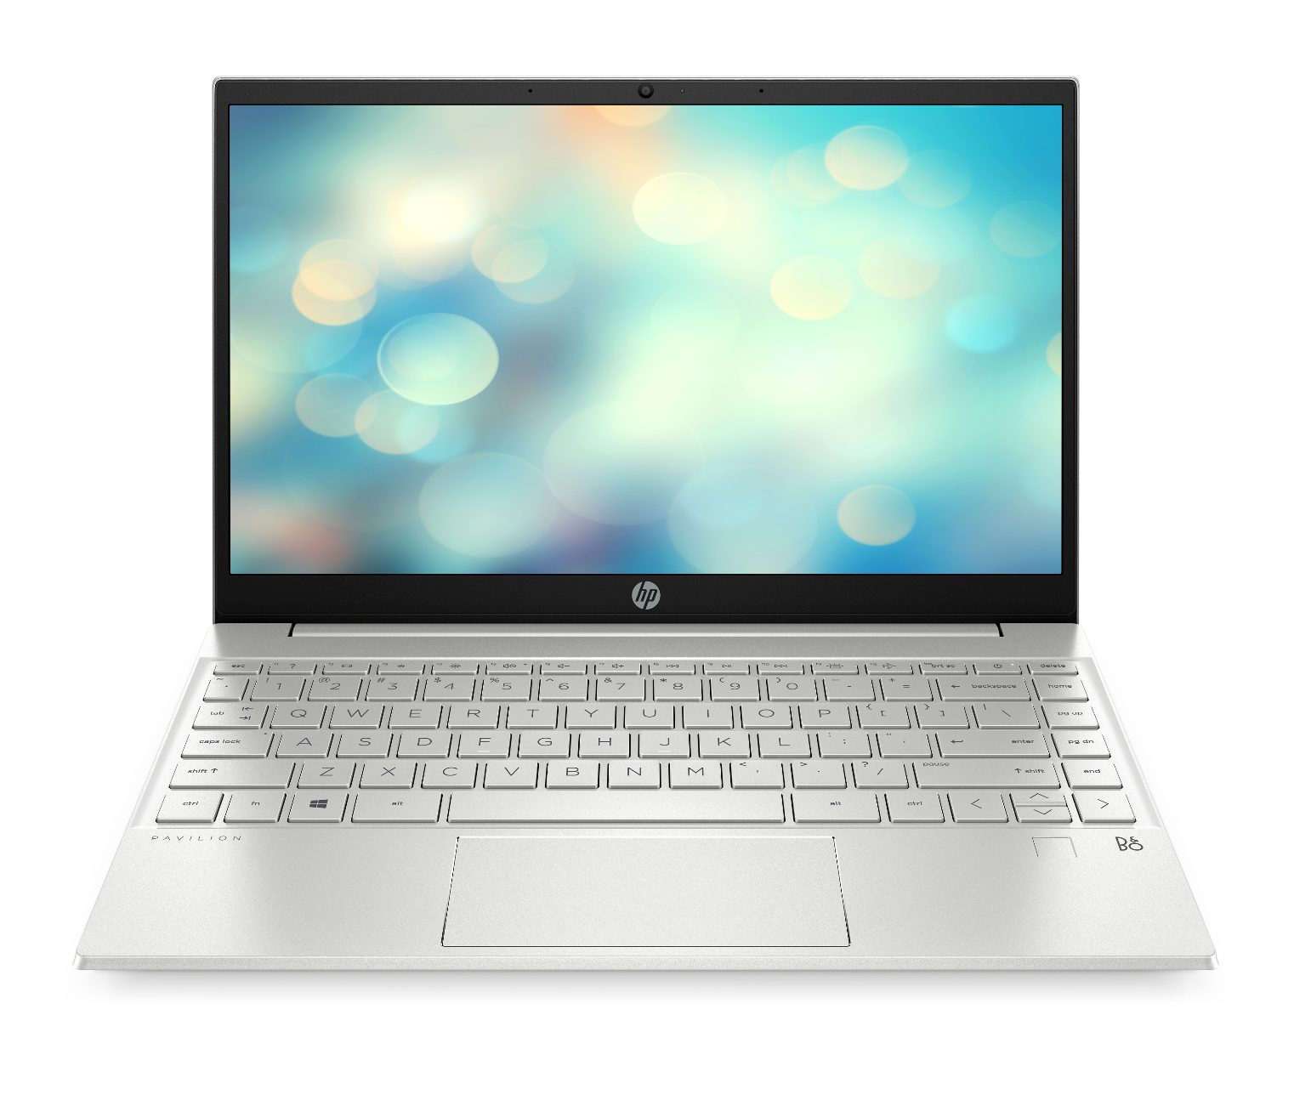
HP Pavilion Aero 13’’
Mezigenerační srovnání
Pavilion 13 (2020)
Vlastnosti
Pavilion 13 (2021)
309 x 205 x 16.9mm
Rozměry
297.6 x 209 x 16.9 mm
1.25kg
Váha
< 1kg
3-stranný rámeček, 84% STBR
Rámečky a STBR
4-stranný rámeček, 90% STBR
16:9
Poměr stran
16:10
FHD (1920x1080); UHD (3840x2160)
Rozlišení
WQXGA (2560 x 1600); WUXGA (1920x1200)
Intel TGL i3/i5/i7/Pentium
Procesor
AMD Ryzen™ 5000 Series Mobile Processors R5/R7
Integrovaná
Grafická karta
Integrovaná
SSD až 1 TB
Úložiště
SSD až 1TB
Čtečka otisku prstů
Zabezpečení
Čtečka otisku prstů
Tradiční velikost
Touchpad
23% Larger Touchpad
Wi-Fi 6 + BT5.0
Připojení
Wi-Fi 6 + BT5.2
USB-C (Data, Power, Video)
USB-C Port
USB-C (Data, Power, Video)
43Whr, až 8.25h (HD/MM18) HP Fast Charge
Baterie
43Whr, až 10.5h (WUXGA/SSD/MM18) HP Fast Charge

Slide 14
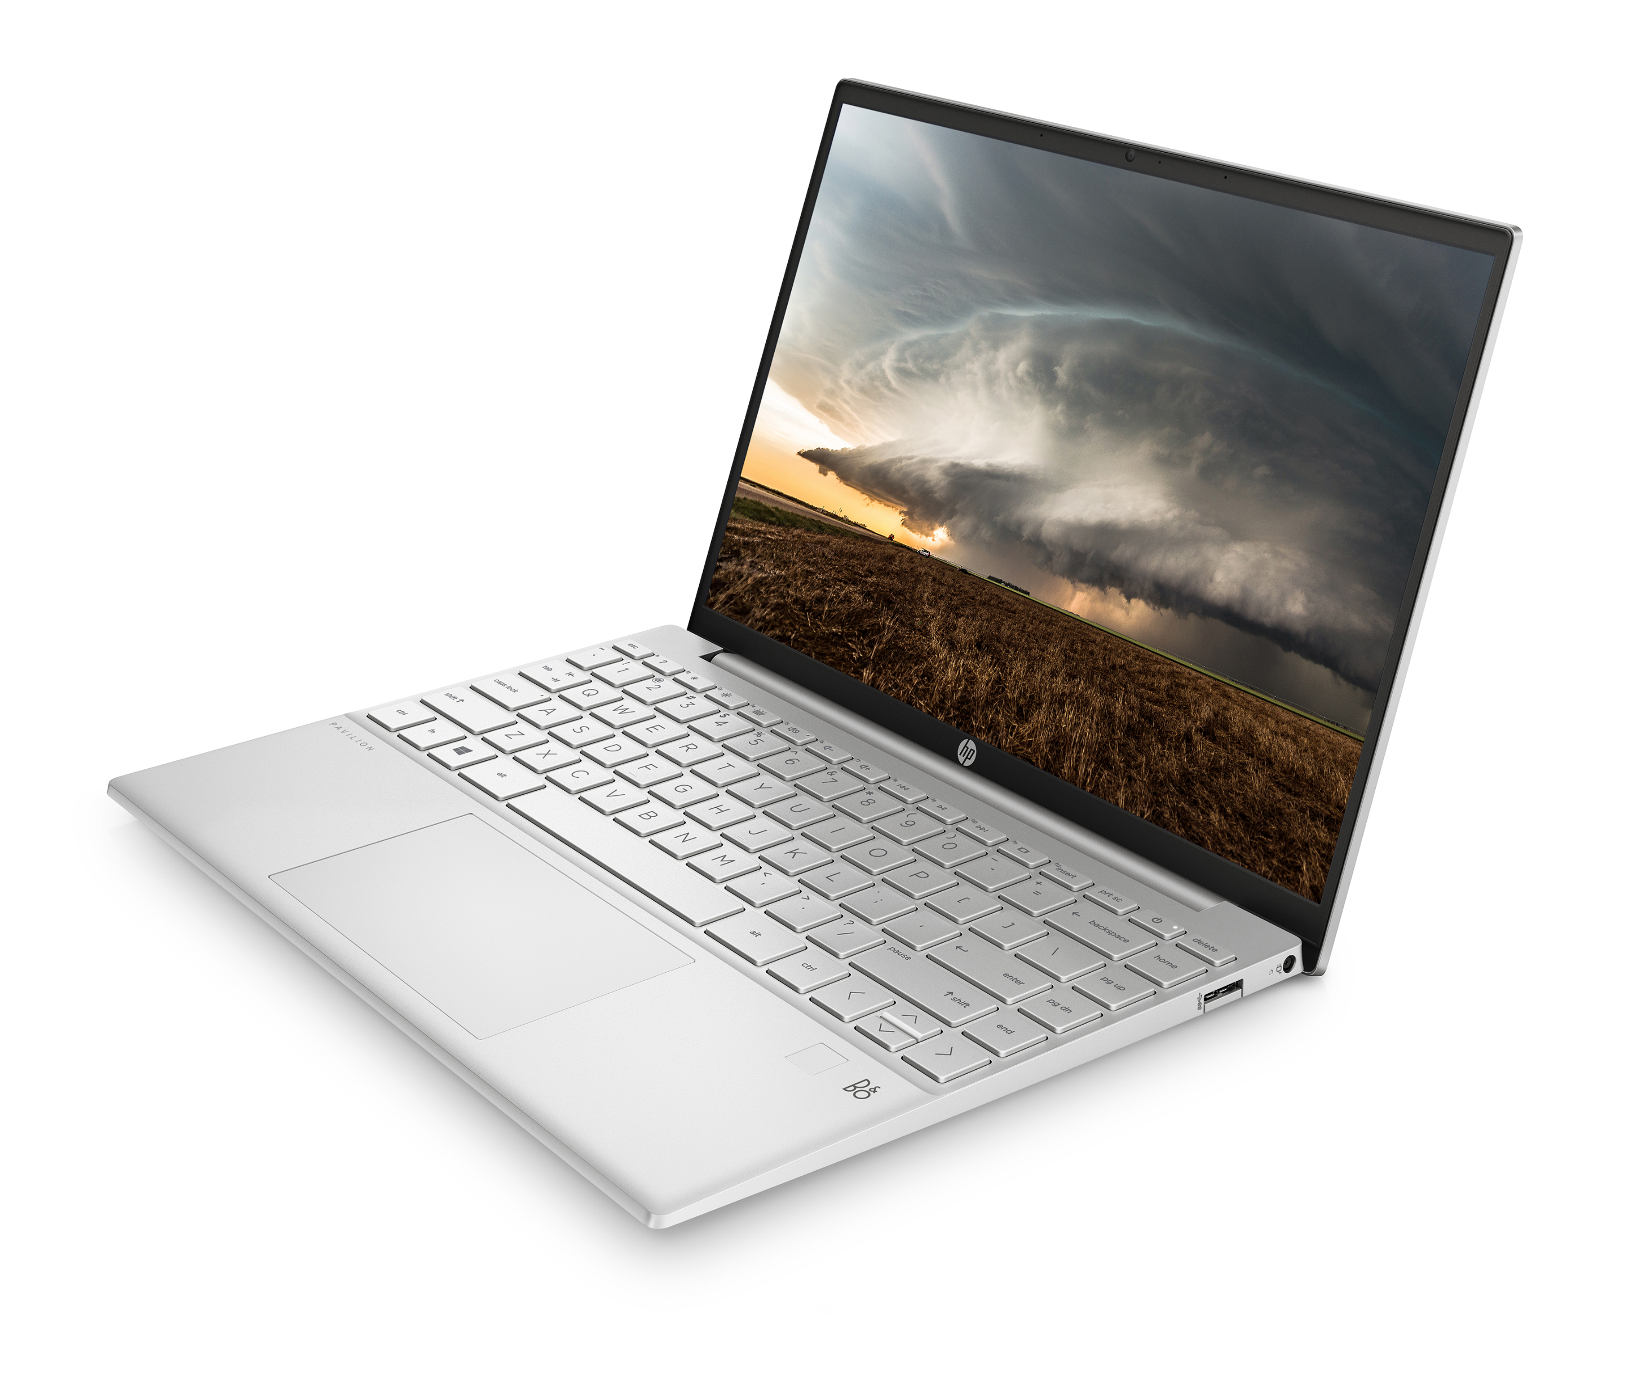
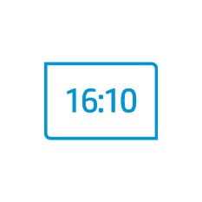
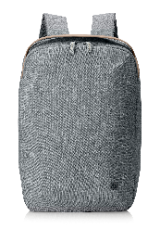
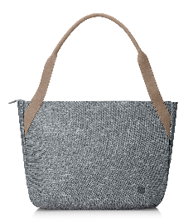
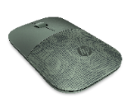
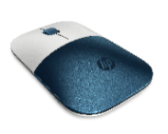
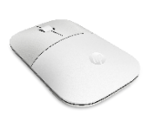
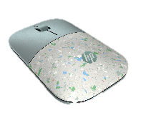
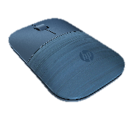
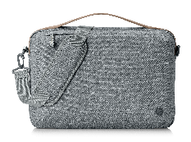
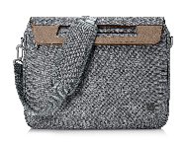
HP Pavilion Aero 13’’
Barevné varianty :
Natural Silver
Ceramic White
Warm Gold
Pale Rose Gold
Silné stránky :
Příslušenství
<1kg
16:10 poměr stran
~90% STBR
HP Wireless Mouse Z3700
HP Renew Bags
Notes:
Alexa Localizations: US, UK, German, India, Japan, Canada, France, Austria, Ireland, Spain, Italy, Australia, New Zealand
(#ABA, #ABU, #ABD, #ACJ, #ACF, #ABJ, #ABL,#ABF, #ABE, #ABZ,#ABG）
(Removed Lid Closed WOV as we have filed DCR to set Lid Close as test only as current demand is low. If there’s any business case, we will trigger this back. For current, you can remove from Sell-in deck as temporary.
*: Target:
Xiaowei/China

Slide 15
HP Pavilion Aero 13’’
Udržitelnost
Než dorazí k vám domů
Vyroben z recyklovaných plastů
Přeprava ve 100% udržitelných materiálech
6k
Použito více než 6 000 plastových lahví vázaných na oceán
Notes:
Recycled plastic used in KB keycap. PCR+OBP in speaker housing.
WBP on A/C/D cover. Reduces VOC (volatile organic compounds) emissions during the production phase
100% outer box packaging and corrugated cushions made from sustainably sourced certified and recycled fibers. Molded pulp cushions made from 100% recycled wood fiber and organic materials. Any plastic cushions are made from >90% recycled plastic. Excludes plastic bags and plastic foam sheeting.
US, Canada, France. Based on U.S. EPEAT® registration according to IEEE 1680.1-2018 EPEAT®. EPEAT® status varies by country. Visit www.epeat.net for more information
Based on HP’s internal analysis as of 3/22/2021. 6,417.32 recycled plastic bottles consumed, based on HP’s projected lifecycle volume. Manufactured recycled ocean bound plastic material in product speaker enclosure. Calculation based on grams per product (using 12.7 grams per 16.9 ounce “single serve” bottled water container) multiplied by projected shipment volume/ 12.7 grams
PCR official description as we follow it per EPEAT guidelines.
Post-consumer recycled plastic (PCR) - [plastic] that has served its intended use and has been discarded for disposal or recovery, having completed its life as a consumer item.
OBP - Plastic waste found within 50 km of an ocean coastline, including rivers, where no municipal or alternative diversion pathway for plastics is available within 100 km of the radius of the site.
EPEAT Silver Registered and Energy Star certified - What is EPEAT?
An ecolabel with the purpose to help customers in the public and private sectors evaluate, compare and select products based on sustainability attributes. EPEAT Gold, Silver and Bronze. Bronze is all sustainable criteria is met. Silver is all criteria plus 50% of optional criteria is met and Gold all criteria plus 75% optional criteria is met
And we are agreed not to call out % of usage on each product due to:
Complex Messaging: Percentage of OBP, PCR, and recycled metal are a mix combination across system parts. For example 50% on A cover but 75% recycled metal on D cover; products under a brand may very as well
Calculation Complexity and LT to finalize number: It still take long time to get a number for claim and so far it cannot hit FCS-8w. A auto system is under study and maybe will be released in 2021C2 or 2022.
Apple’s 100% recycled metal claim: Until now, we still cannot find a way and understand why Apple can claim 100%. By publishing 100% for consumer may cause challenges of why we cannot hit 100% even though 50% or 75% should be almost the leader in the industry.
Focus more on the impact we can do: instead of % of usage, I think what we want to focus more is the real impact to the earth, like CO2 saving, water bottle waste saving(from ocean bound), or 2nd hand plastic part saving for the whole life cycle. And also what we are doing is to create a product not just using materials from recycled part, but also can be recycled again.
There is a regulatory and factory requirement in China to use non-VOC paint, but the rest of painting parts on Zurg are either using exemption or low VOC solution, as the product will mainly sell in China, its best to keep low profile and not have water-based paint as a KSP.

Slide 16
HP Pavilion Aero 13’’
DĚKUJI ZA POZORNOST
Notes:
Portability and weight have constantly shown up in user surveys as one of the top items where HP can do better.
Our insights show that Portability is ranked high, in the top half, as a key motivation for purchasing a PC. (Source: HP Consumer Device Behavior, Understanding Observed Use of PCs, Smartphones, and Tablets (Oct 2019).)
Weight condition:
Magnesium alloy TP bracket
Aluminum Fan cover
0.3t Aluminum KB supporting bracket
Aluminum Thermal fin
0.9mm PCB thickness
Magnesium Alloy Chassis (A/C/D cover)
Weight includes FPR, Backlit keyboard, excludes lid-closed WOV
Under 1kg (2.2lbs)

